Slide 1

Annual
Meeting
November 2025
1

Slide 2
President’s Report – Mike Rennie
President’s Role: Supporting the teams
  As President, my focus is on strengthening the foundation that allows our mission to thrive.
Deepen Operational Understanding
  Actively learning the inner workings of each team to better align leadership with day-to-day realities.
  Added and manage a second line for contacts that allows texting. Primarily a “customer service line”. Most questions are adoption related which drove a updates to the website.
Enhance Governance & Oversight
  Strengthening financial controls and operational policies to ensure transparency, sustainability, and trust.

Slide 3
Vice President’s Report – Cindi Mullin
Strategic Contributions:
Collaboratively updated job descriptions to clarify team roles
Researched and updated the Codes of Conduct and Ethics
Reviewed and updated policies to reflect our evolving needs and uphold our shared values
Contributed to the organization’s rebranding and designed new T-shirts for brand marketing
Focus on process improvement across all operational areas
Supports collaboration, operational efficiency, and policy implementation

Slide 4
Treasurer’s Report – Pam Whitney
  Thanks to the generosity of our donors, grantors, and those who have made bequests to our rescue, our organization remains financially strong and well-supported.
  Over the past several years, we've increased our income by strategically investing in short-term Certificates of Deposit. This approach has allowed us to earn substantial interest, strengthening our financial position.
Financial Information
Thousands of US$
Income | 2024 | Sep-25
Donations | $ 59 | $ 85
Grants | 75 | 73
Adoption Fee | 41 | 36
Events | 12 | 3
Others (membership/investment) | 75 | 54
Total Income | $ 262 | $ 251
Expenses
Vet Care | 190 | 183
Events | 5 | 2
Insurance/Investment | 5 | 8
Storage/Website/Bank Fees | 24 | 11
Total Expenses | $ 224 | $ 204
Net Proceeds | $ 38 | $ 47
Available Funds | $ 578 | $ 619

Slide 5
Secretary’s Report – Judi Schillaci
  Policy Manual (Summary):
    Working with the V.P., there have been several amendments to our Policy Manual this year to address financial and accounting policies, ethics, volunteer compensation, and changes to dog policies. The manual is posted in its entirety on our website.
  Grants and Bequests:
    Income from grants, bequests, and distributions from the Arizona Community Foundation total approximately $98,500 so far this year.
  Succession Planning:
    My term as Secretary will end October 2026. I will be seeking candidates for this board position; have created templates for agendas, minutes, board motions/resolutions, etc. to make record-keeping simple and efficient.
    I will also be stepping down from my role as Grant Writer and Donor Relations Coordinator. I welcome interest from volunteers in these positions.
    Please email me at judithschillaci49@gmail.com if you would like information about any of these volunteer jobs.

Slide 6
Director of Golden Operations’ Report – Bob Schillaci
  One of the major tasks this year was to expand our Veterinary Partnerships, and we have achieved this by expanding our use of Dr. Kelly’s locations as well as new vets in Vistancia and Maricopa. Dr. Kelly’s has now opened a new clinic in Flagstaff which fills a gap in the north, and they are already in Tucson. We still need a vet in the Ahwatukee region and to that end we’ll be checking with previous adopters in that area for recommendations.
  Vet Care, Placement, Behavior and Microchip Manager are fully staffed and functioning like a well-oiled machine.
  I will be looking for a successor as Director of Golden Operations. That will give me plenty of time to train and the job has gotten easier over the last year.
  Finally, I want to thank my team leaders, Judy Smith - Vet Care, Kathie McIsaac - Placement, D. J. Jenkins - Behavior and Dianne Nevius - Microchip Manager for stepping up and keeping the operation running during my illness last Spring and Summer. You ladies took a lot of the stress off me and I appreciate it.

Slide 7
Director of Golden Rescue Report Kerri Crabtree - 2025 Highlights
This year has been Golden in every sense full of wagging tails, whirlwind schedules, and heartwarming wins. As Director of Golden Operations, I’ve had the privilege of supporting the powerhouse teams behind our mission: Woof Line, Intake, Home Visit, and Transport.
Year-to-Date Impact
 105+ Goldens welcomed through Intake
 129+ Woof Line calls answered with care
 145+ Transports coordinated across the Valley
 168+ Home Visits completed to match dogs with their perfect people
 300+ Applications
Challenges Tackled with Grit & Grace
Navigated volunteer availability shifts with flexibility and good humor
Responded to emergency intakes with speed and compassion
Balanced the expectations of OTIs and adopters ensuring every Golden’s story ends in a happy tail
Team Building & Growth
Partnered with team leads to recruit and onboard new volunteers across Intake, Home Visit, Transport, and Transport Coordinator roles
Continued learning from each team to better support their evolving needs and celebrate their wins

Slide 8
Director of Community Relations Report – Stephanie Corns
Strategized new and more impactful ways to increase our visibility among stakeholders who can help advance our mission
Built on our modernized approach to the annual fundraising campaign, generating more than $40,000 last year.
  Campaign saw great member engagement with multiple members contributing thousands of dollars to special 2:1 matches that energized donations throughout the month
Led Fiesta Bowl Parade participation, including coordinating logistics with parade organizers, recruiting members and their Golden to walk with us, participant communications, selling shirts in advance, etc.
  Revised plan for 2025 parade to improve communications, increase attendance, proactively address questions, streamline back-end logistics, etc.
Organized annual party for 100+ members and their Goldens, including catering, communications, setup, etc.

Slide 9
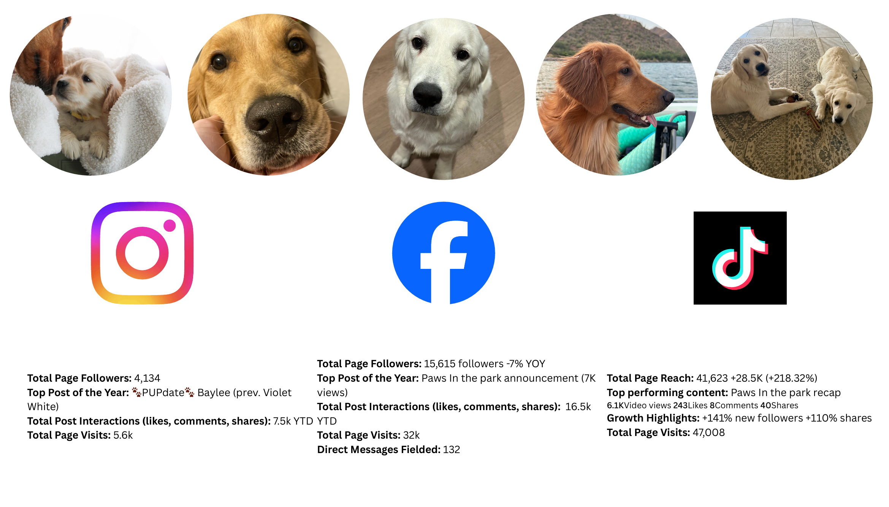
Director of Social Media– Kymber Horvath

Slide 10
Director at Large – Michelle Dalby
Spring: Paws in the Park, new donation vests made and sent to Northern/Southern AZ (plus some with me).
  Fun event and well attended 60+ in Tempe
Summer: Took over Merchandise distribution - going well! Trips to post office 2 time per week.
Fall: Howl-o-ween Pawty!
  We had such a great time! Estimated about 40+ people came. Brunch vs lunch went well.

